Slide 1
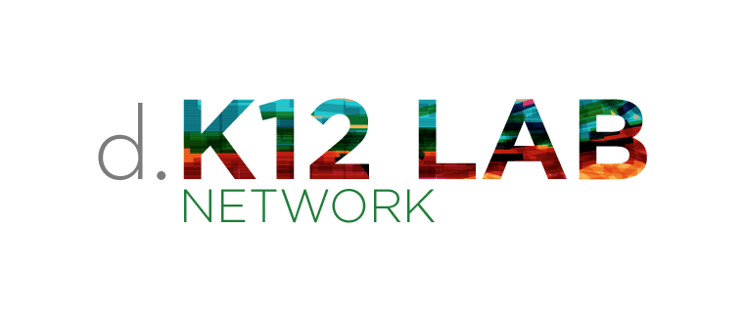
We inspire + develop the creative confidence of educators + support innovators catalyzing powerful models for teaching and learning.
Notes:
We believe you all are designers as educators.
Educators shape how students experience the world. Educators design products, spaces, processes & systems.
Teachers design intuitively, but not necessarily intentionally.
We help teachers see themselves as designers.

Slide 2


Any system produces what it was designed to produce.
Image credit: flickr.com/dagnyg
Notes:
Courtesy of National Equity Project

Slide 3
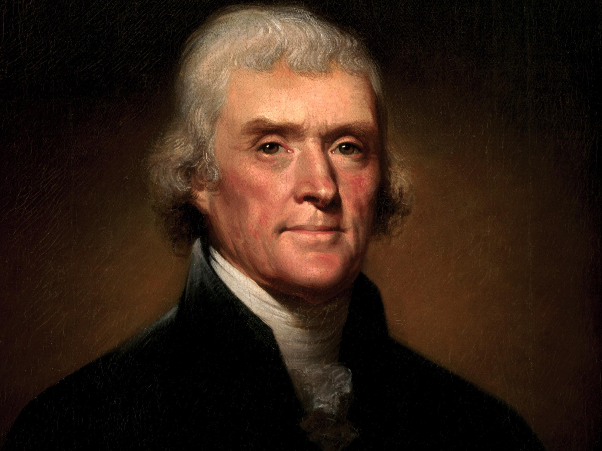
Image credit: http://wikimedia.org
1779: Thomas Jefferson proposes a two-track educational system, with different tracks for (in his words) “the laboring and the learned.”
Scholarships would allow a select few of the laboring class to advance by “raking a few geniuses from the rubbish.”
Notes:
Our education system in America was not designed to serve all students well.
Courtesy of National Equity Project

Slide 4
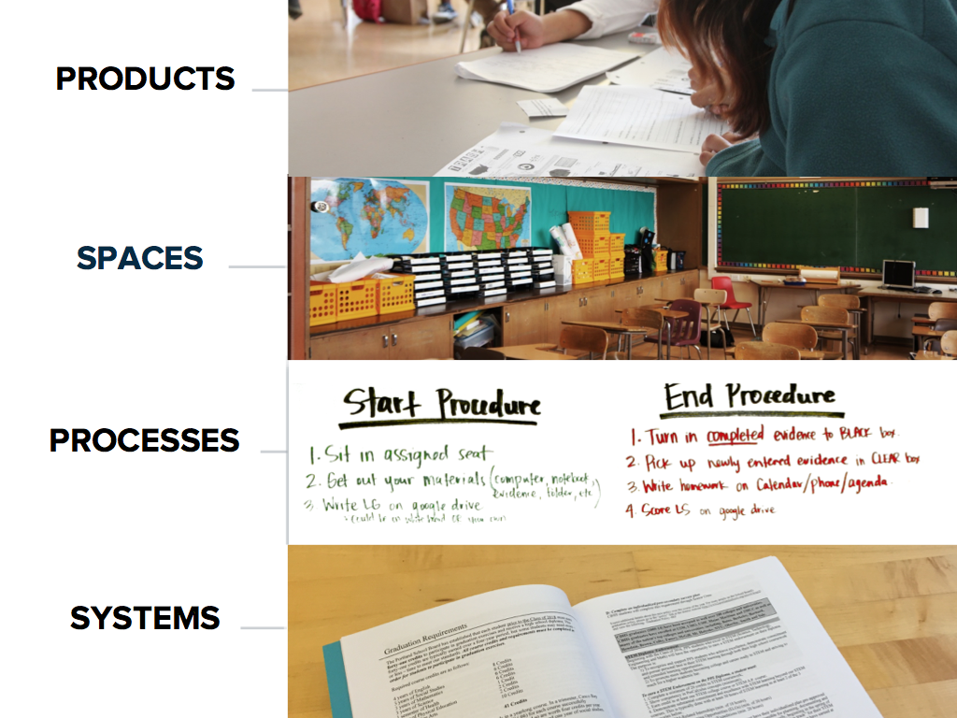
Notes:
Slides 4-7 from School Retool
We believe you all are designers as educators.
Educators shape how students experience the world. Educators design
<click> “products” like curriculum
<click> spaces
<click> processes
<click> and systems...
Teachers design intuitively, but not necessarily intentionally.
We help teachers see themselves as designers.

Slide 5
Notes:
We believe you all are designers as educators.
Educators shape how students experience the world. Educators design
<click> “products” like curriculum
<click> spaces
<click> processes
<click> and systems...
Teachers design intuitively, but not necessarily intentionally.
We help teachers see themselves as designers.

Slide 6
Notes:
We believe you all are designers as educators.
Educators shape how students experience the world. Educators design
<click> “products” like curriculum
<click> spaces
<click> processes
<click> and systems...
Teachers design intuitively, but not necessarily intentionally.
We help teachers see themselves as designers.

Slide 7
Notes:
We believe you all are designers as educators.
Educators shape how students experience the world. Educators design
<click> “products” like curriculum
<click> spaces
<click> processes
<click> and systems...
Teachers design intuitively, but not necessarily intentionally.
We help teachers see themselves as designers.

Slide 8
Design Dilemma of Habit
Design can often fail to address root causes of inequity – & can reproduce inequitable power relationships
Notes:
We also believe if we as designers are not aware of the biases and baggage we are bringing to every context and relationship we are designing with/in then we run the high risk of reproducing power relationships: admin/teacher, teacher/student/ academics/arts, male/female, white/black/Latinx/Asian/indigenous, new teacher/seasoned teacher

Slide 9
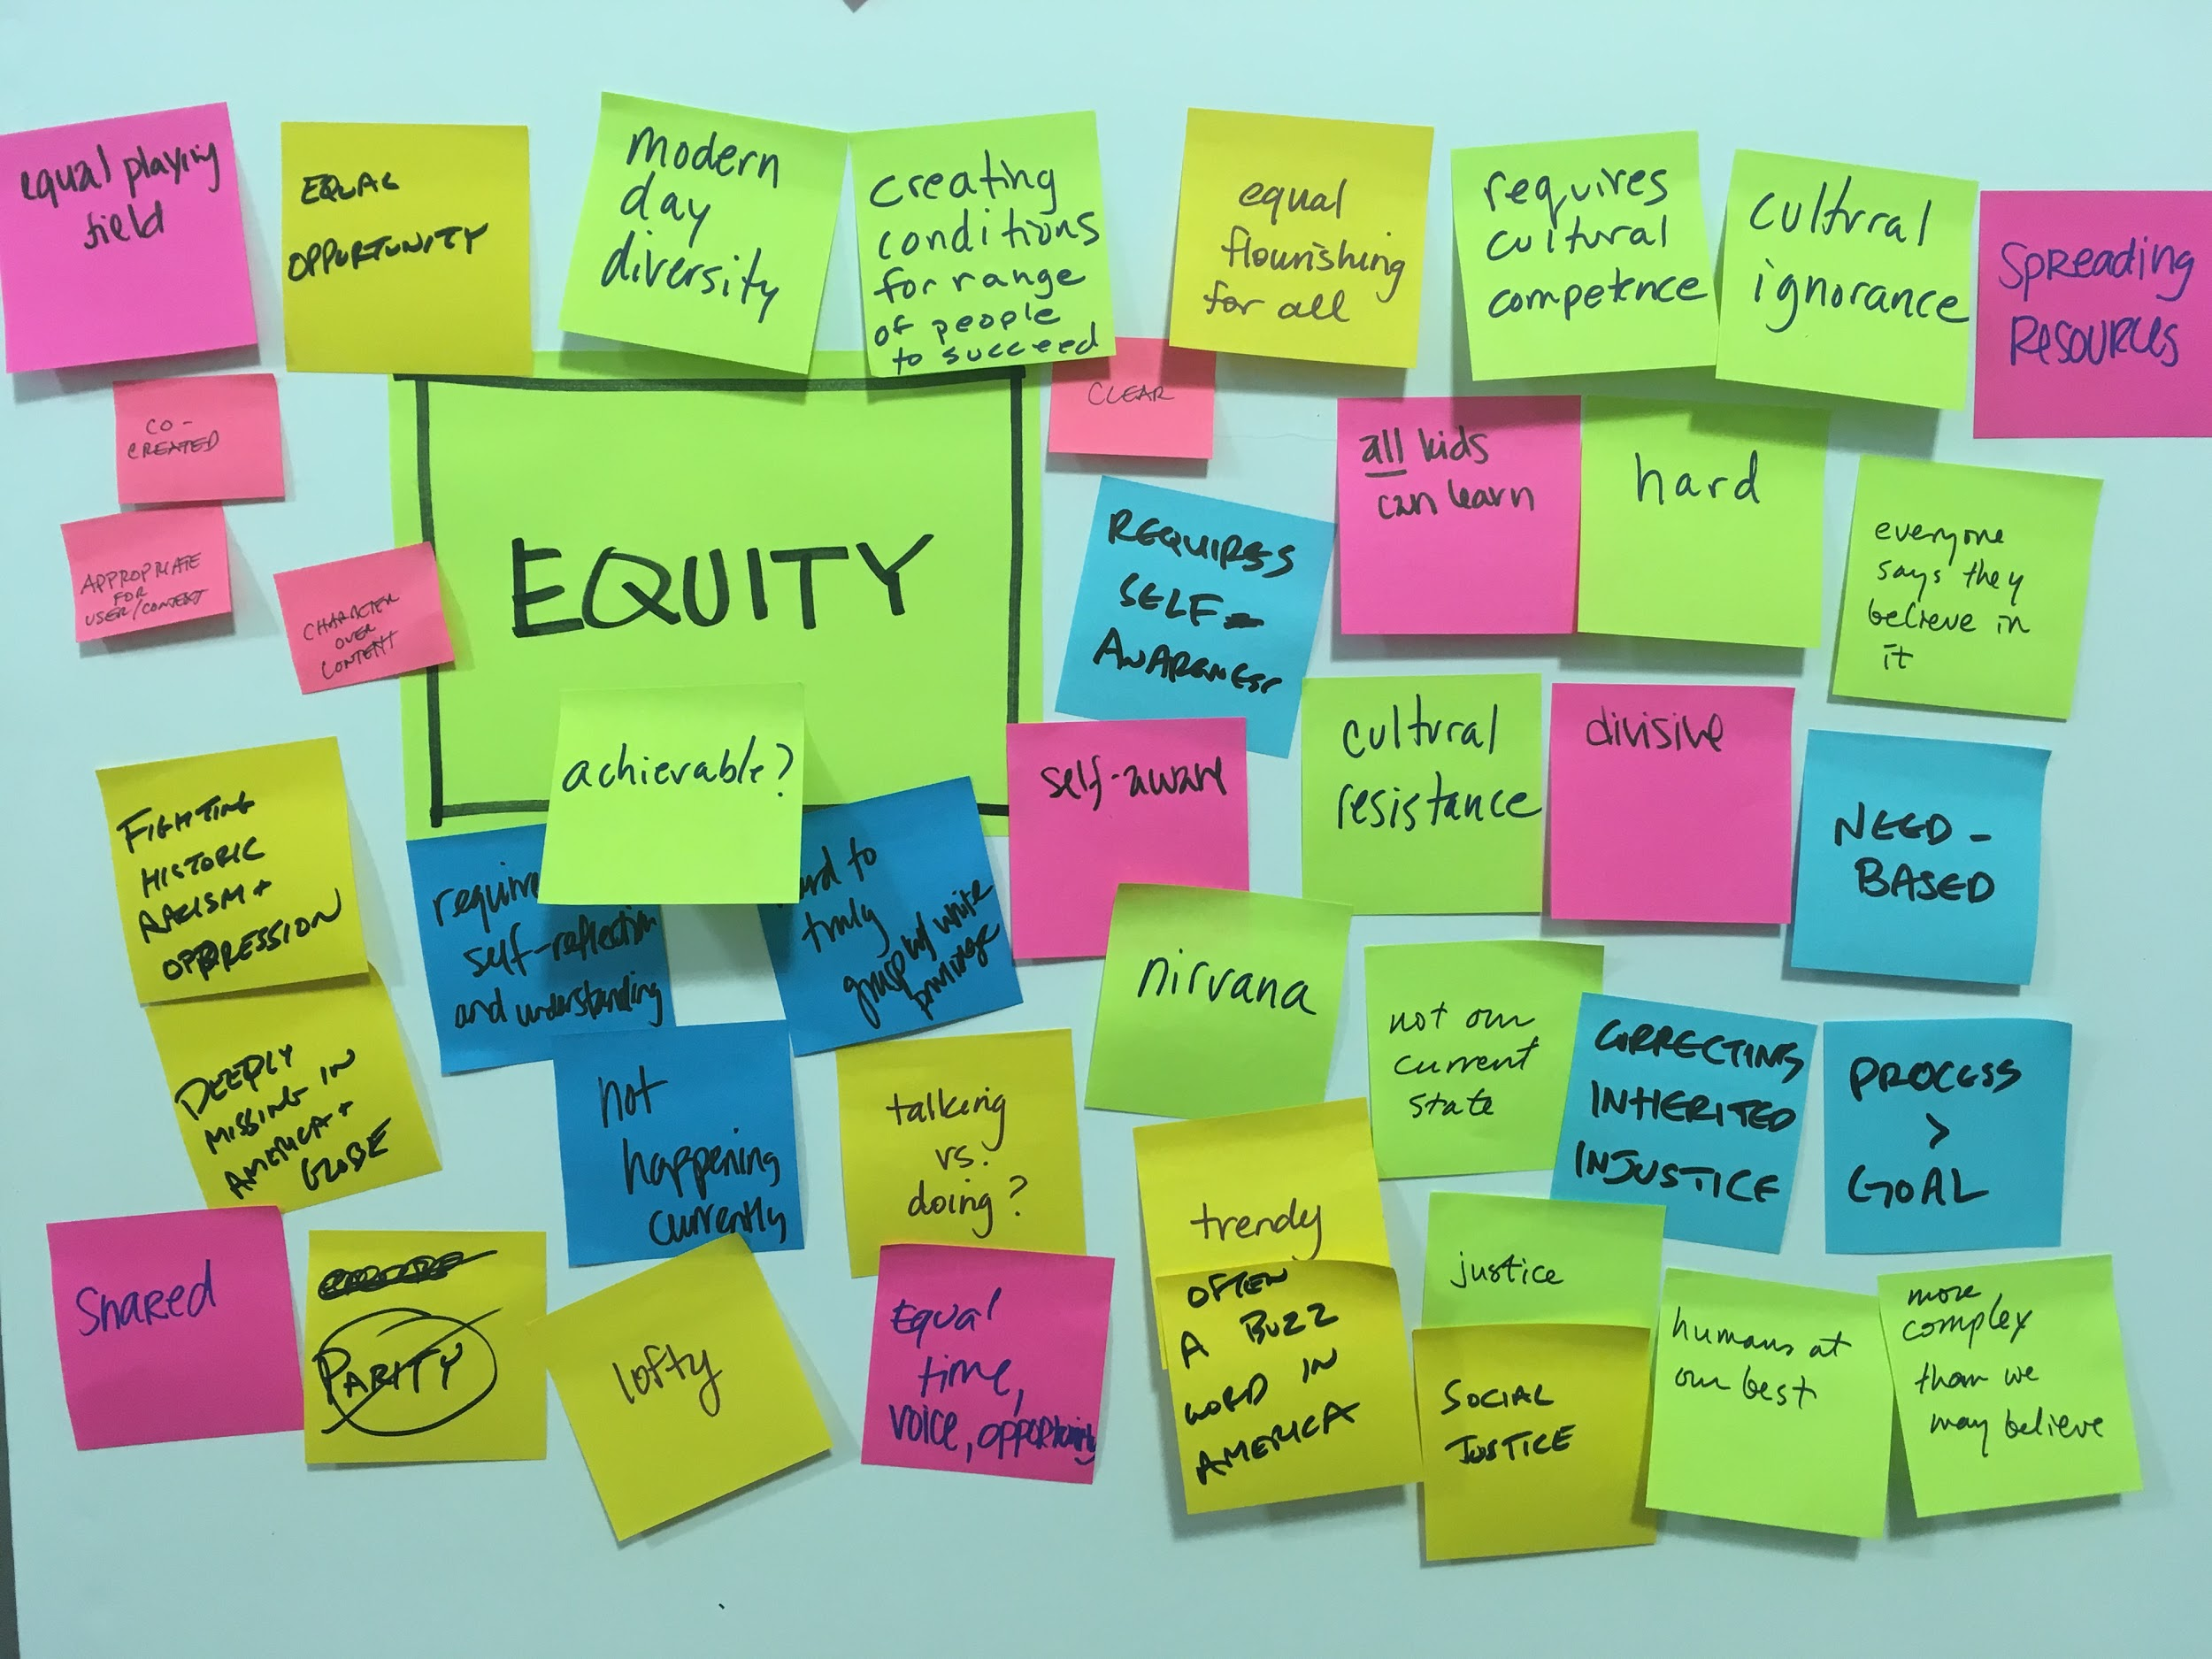
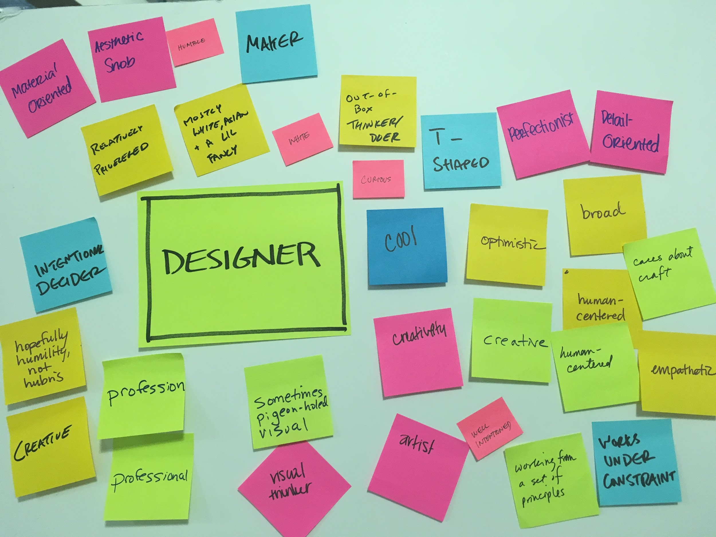
Design Thinking + Equitable Practices = Equity-Centered Design
Notes:
In spring 2016, we started exploring intersection of design thinking and diversity, inclusion and equity. We reached out to the National Equity Project and the Equity Design Collaborative to help us develop our equity consciousness practice and to prototype with

Slide 10
Equity + Design Dilemmas of Habit
Equity work often lacks an intentional & powerful approach to design & creativity
Design can often fail to address root causes of inequity – & can reproduce inequitable power relationships
Notes:
Courtesy of #liberatorydesign

Slide 11
Equity + Design Dilemmas of Habit
Design Opportunity
Equity work often lacks an intentional & powerful approach to design & creativity
Design can often fail to address root causes of inequity – & can reproduce inequitable power relationships
Notes:
Courtesy of #liberatorydesign

Slide 12
Equity-Centered Design
Being intentional
about/with:
The “User(s)”
The “Designer(s)”
Their Relationships
The Design
The Impact of the Design
For greater equity

Slide 13

How can design thinking powerfully serve as a force for equity + address the effects of oppression on education?
Notes:
Courtesy of #liberatorydesign (a collaboration between the National Equity Project and the K12 Lab)

Slide 14
equity?

Slide 15
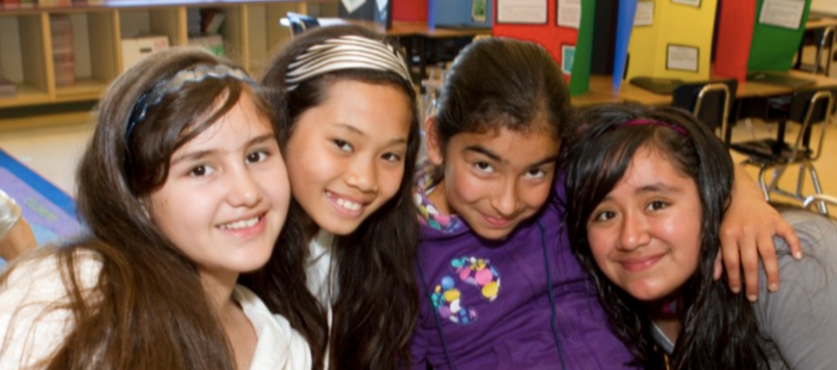
Equity means every child receives what they need to develop to their full academic and social potential.
Notes:
What does equity mean? This is our working definition from our collaborator, the National Equity Project.

Slide 16
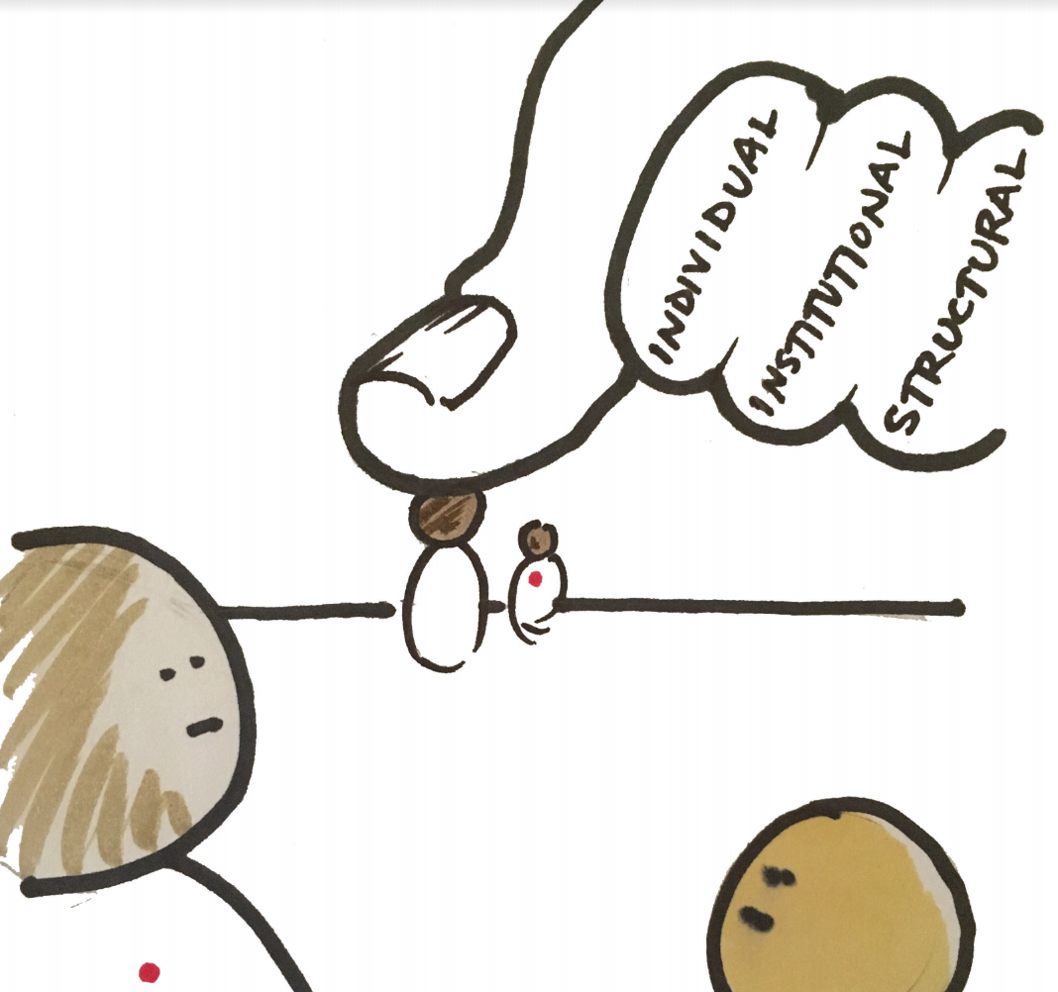
Oppression
A system of unjust treatment built into our daily life, beyond individual acts. It affects everything we do (learning, leading, teaching, designing, improving).
Notes:
What is oppression?
Oppression is a system that is built into our daily life and stems beyond individual acts. We may notice different types of oppression, individual, institutional, structural, and it affects everything we do. Learning, leading, teaching, designing, improving. By noticing oppression and how it affects us, we have the opportunity to make sure our design and improvement work produce greater equity.

Slide 17

A “map” of Systemic Oppression
Blindness to the reality of systemic oppression...
INDIVIDUAL
SYSTEMIC
Identity & difference
Biased policies & practices
Reproductive discourse (discourse 1)
Advantage & disadvantage
Institutional
Microaggressions
Individual
Racist interactions
Disproportional (e.g. racialized) outcomes
Explicit Bias
Interpersonal
Systems of Advantage & Disadvantage
Implicit Bias
Transferred oppression
Stereotype Threat
Structural
Internalized oppression
Opportunity structures
Notes:
Courtesy of National Equity Project

Slide 18
A(partial) “map” of Liberation...
Awareness of the reality of systemic oppression - and agency to interrupt it...
INTERNAL
EXTERNAL
Recognizing identity & difference
Discourse 2
Equity-centered policies & practices
Community Agreements
Institutional
Individual
Interpersonal
Equity-centered design & learning
Recognizing and owning our privilege & disadvantage
Equitable outcomes
Alliances (across & within difference)
Organizing & Protest
Reflection & Self-inquiry
Constructivist Listening
Structural
Learning (read, watch, talk)
Systems of
Notes:
Courtesy of National Equity Project

Slide 19
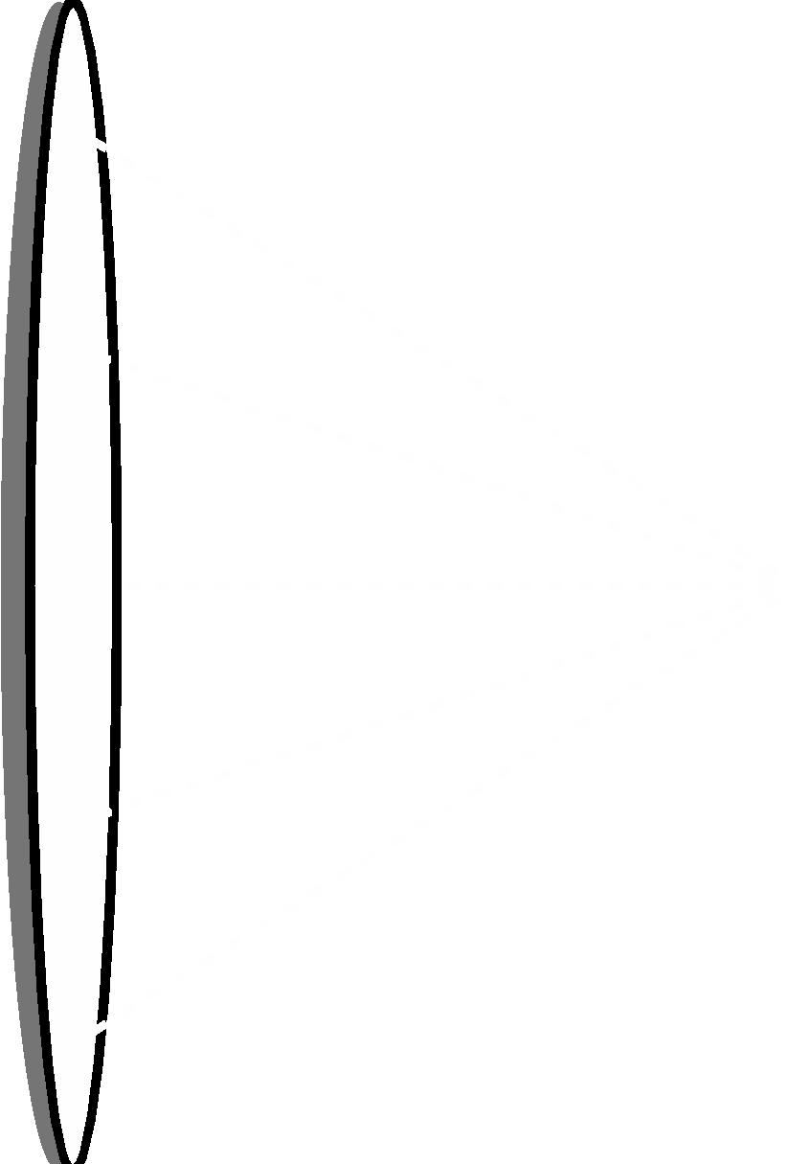
Equity Lens
The metaphor of a lens allows us to see our contexts in new and revealing ways.
POLICIES
OUTCOMES
POWER
RELATIONSHIPS
SOLUTIONS
How might we design with intention to eliminate oppression?
Notes:
How might we design with intention to eliminate oppression?
Courtesy of National Equity Project
Contribution from Reina Cabezas at Oakland Unified School District
“Whenever I arrive on a real location, I have to move around and work out what the
best angles are going to be. When I was moving around with the lens, I discovered
things that the naked eye would not have.” – filmmaker Pedro Almodovar

Slide 20
Building your equity lens
Notes:
A few tools and techniques
Before during and after empathizing. We will focus today on before

Slide 21
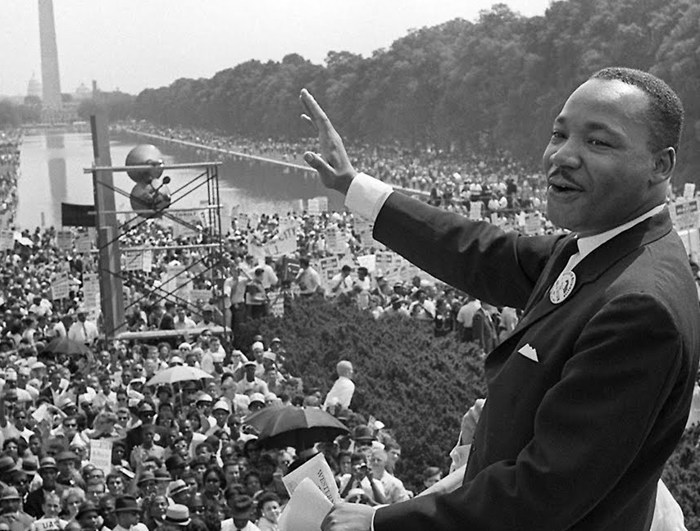
Leading from the Inside-Out
“All meaningful and lasting change begins on the inside.”
- Martin Luther King, Jr.
Notes:
‹#›

Slide 22

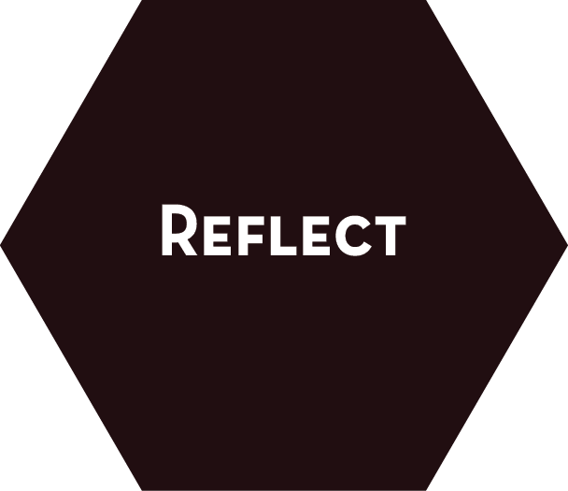
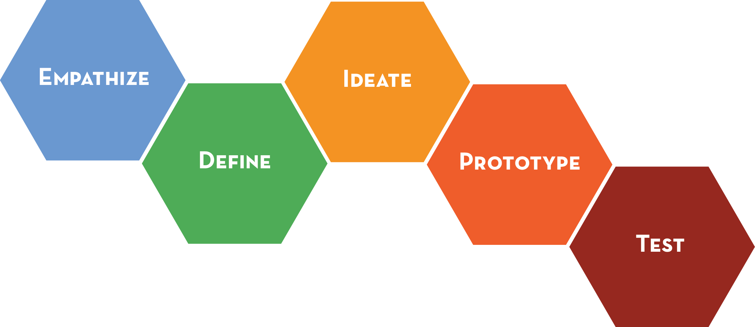
Notes:
ANIMATED: Introduce a new frame developed out of the K12 Lab at the d.school.
Framing this as equity-centred design thinking Design thinking. This equity-centred practice creates the opportunities for the equity practitioner and the designers to build from their skillsets and develop a new approach to their work. THE PRACTICE This is not a step in the traditional DT process - this is something we are introducing to our DTK12 work. We will be bringing in new curriculum around this area, want feedback, your thoughts, ways you can connect this to your own work and life.
So really, being aware of and reflecting on the impact of your own beliefs and biases in relationship with/to your users and their context is practiced throughout the design thinking process.

Slide 23

ACKNOWLEDGE
Power, Identity, Context
REVEAL
Your Authentic Self + Opportunities to
Liberate
Notes:
The notice phase helps designers develop a self and social-emotional awareness before entering any context or practice of empathy. This phase focuses on you, the designer, in order to build a practice of self-awareness of your own identity, values, emotions, biases, assumptions and situatedness in order to reveal your authentic self; accept and build from what you don’t know so that you, as designer, can empathize with humility, curiosity and courage. Noticing what one brings to any person and context allows for authentic human centered design, not “you” centered design.

Slide 24
What to NOTICE
Identity: Who am I/we? Who are our users?
Power: How are we respectively situated (relative to opportunity, institutional power)?
Context: What is our situation, our equity challenges?
Partnership: Given the above, how can we create a partnership that is liberating for all in the process?
Intention: … So that what we design generates increased equity
Notes:
ANIMATED
Courtesy of Tom Malarkey at The National Equity Project

Slide 25
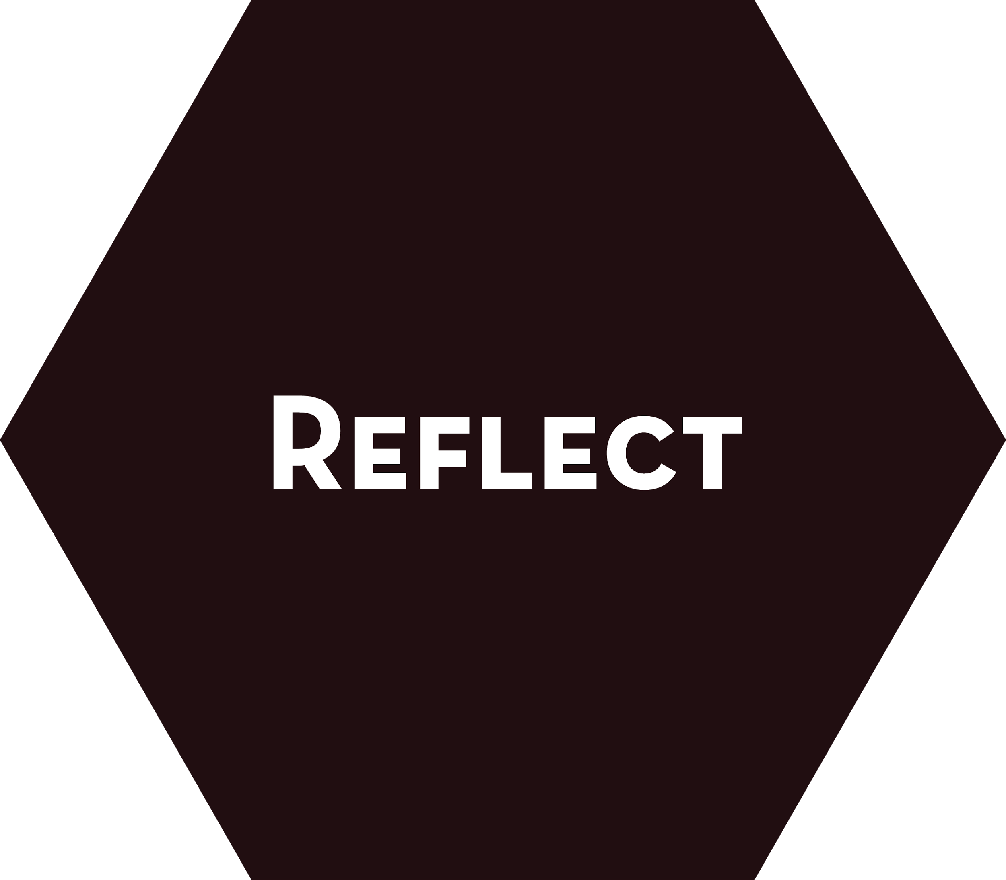
NOTICE
Emotions, actions, insights + impact
SHARE
Our learning, our process + Opportunities to Co-Design
Notes:
The REFLECT phase of the process is ongoing and transparent throughout the design thinking process. It allows you and your team the time to notice, focus and reflect on your actions, emotions, insights and impact as designer(s) and human(s) on/with your users/context. It is was is called an Equity Pause by EquityXDesign. It is a time to share our learning and see what we can do better* next time.
*Inclusive, equitable and aesthetic.
What evidence do I have that I am becoming more self aware and self correcting as an equity leader using liberatory design?
What would others say?

Slide 26
EQUITY
Notice self, power + oppression
PAUSE
to notice emotions, new understanding + Challenge Power
Notes:
“Equity Pauses” from equityXdesign
https://medium.com/@multiplyequity/racism-and-inequity-are-products-of-design-they-can-be-redesigned-12188363cc6a#.8hia4f29y
“A sense of urgency can mask hegemonic strategy. Our common discourse of urgency and business-as-usual creates little time for reflection; our pace of life eclipses our awareness. Strategic equity pauses stop the clock to reflect on our language, ideas, and hunches in the context of a discourse of transformation. Without this moment to think, our brains default to the familiar and the known, making a repeat of past practice likely. Incorporating these discourse checks and pauses after each stage ensures that our ideas remain on the path of achieving equity.”

Slide 27
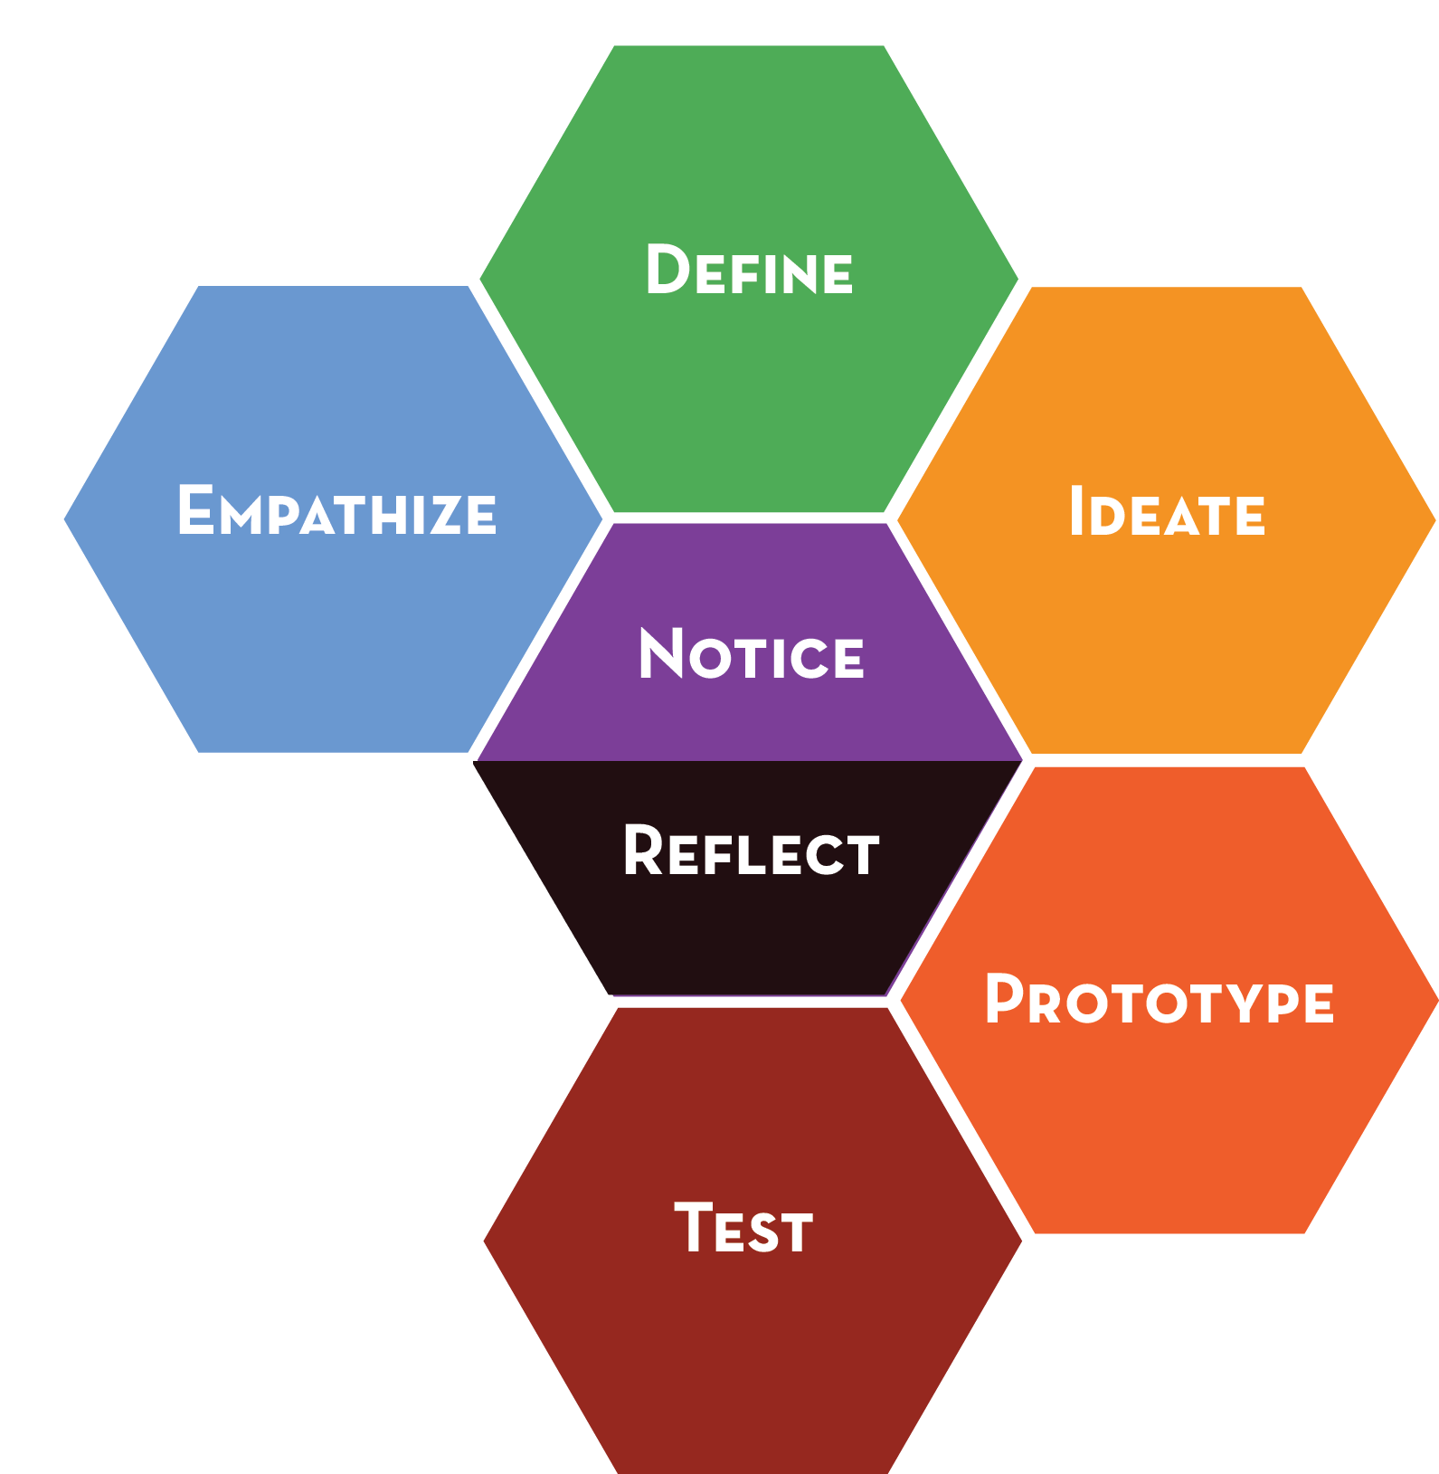
Notes:
The practice of equity centered design THE equity-centered DESIGNER emerges. One that was more self-aware, more inclusive and inspired, shared the design practice and construction of humanity?

Slide 28
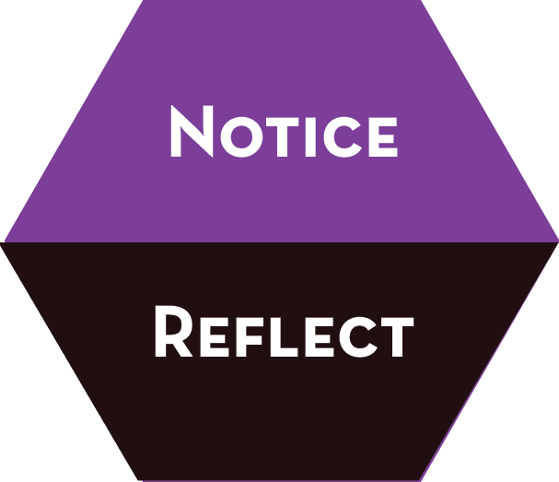
IDENTITY
POWER
INTENTION
CONTEXT
PARTNERSHIP
Notes:
The Self-Aware Designer

Slide 29
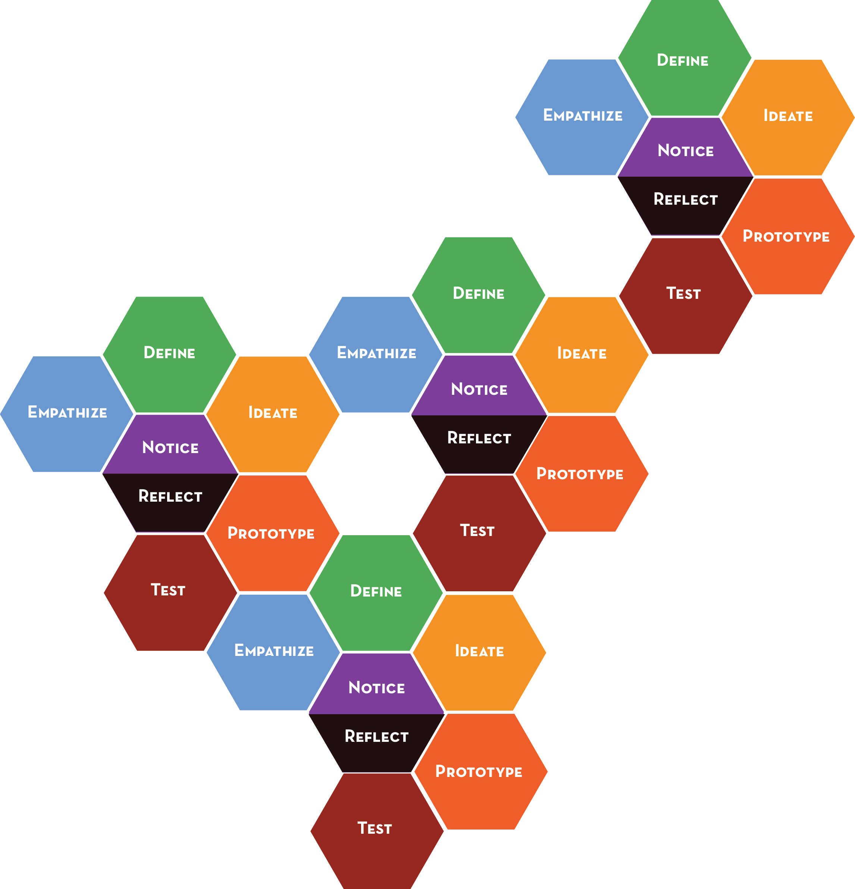
Notes:
The CO-CREATION of opportunities to practice this ethos with others This shared ethos then regenerates...

Slide 30
Notes:
And regenerates...

Slide 31
Notes:
To create shared truths, stories, and ultimately learning.
We will share some activities with you throughout the workshop that begin to build this muscle
The mechanism for going viral is relationship and shared purpose and possibility

Slide 32
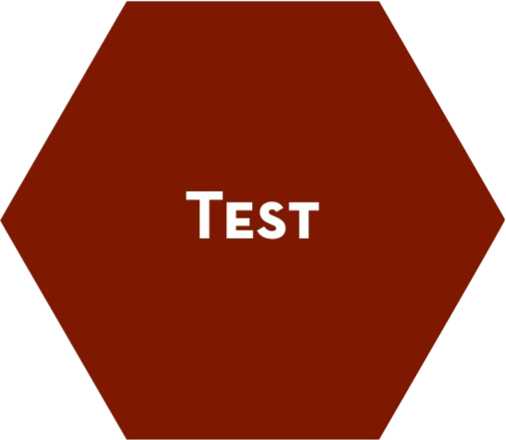
NOTICE
Emotions, actions, insights + impact
SHARE
Our learning, our process + Opportunities to Co-Design
Notes:
Reminder: It is important to pause (as a team or individual) to notice and reflect on emotions, dynamics, actions, blindspots, etc.
The REFLECT phase of the process is ongoing and transparent throughout the design thinking process. It allows you and your team the time to notice, focus and reflect on your actions, emotions, insights and impact as designer(s) and human(s) on/with your users/context.

Slide 33
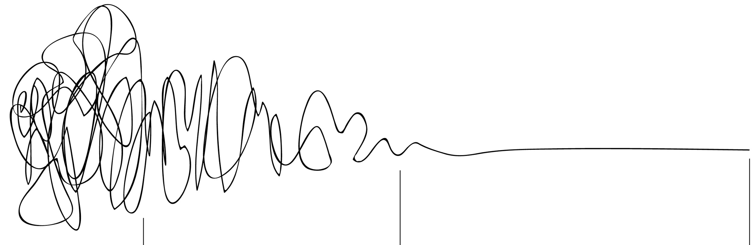
This sucks!
“A-ha!”
“I got this”
F*$k This!
I suck!
Notes:
This slide shown during a workshop before the design process and after REALLY helps validate how some participants might feel/have felt during the workshop. After a design challenge you can ask, “How many felt this, this and this during the design thinking process?
This graphic acknowledges people’s feelings and normalizes what (white) designers may take for granted.

Slide 34
Courage
Sense of Humor
Willingness to look foolish
Preparation
Love
Humility
Reflect on self, biases + process
Notes:
These are skills practiced during the equity-centered design practice

Slide 35
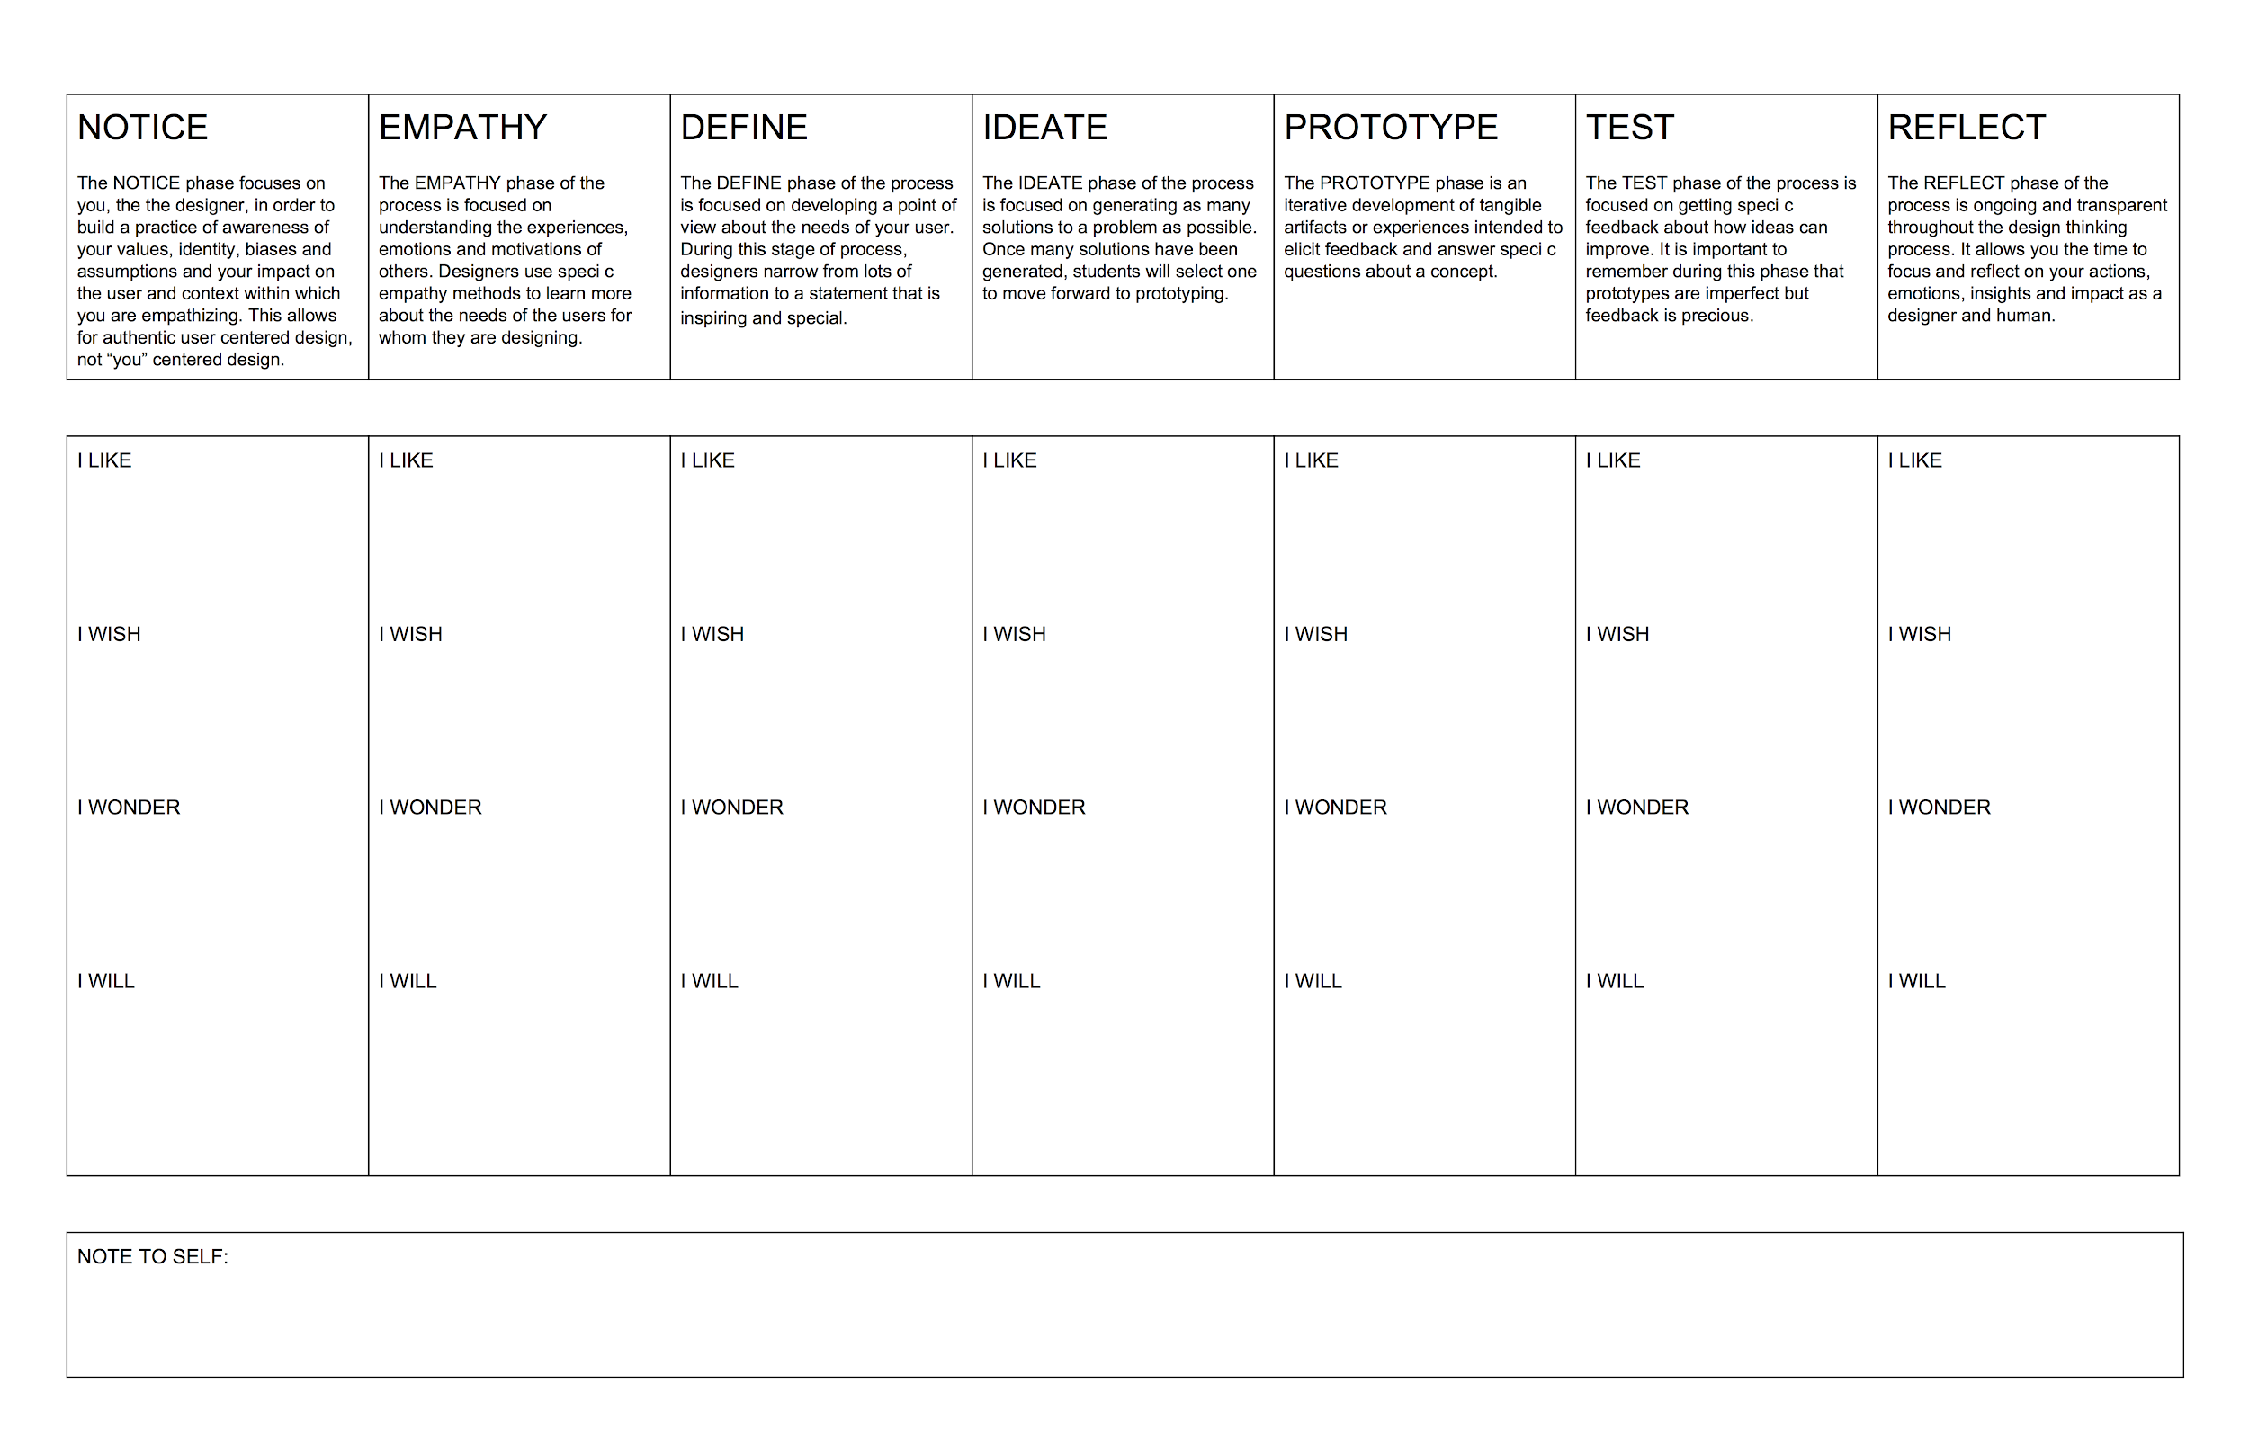
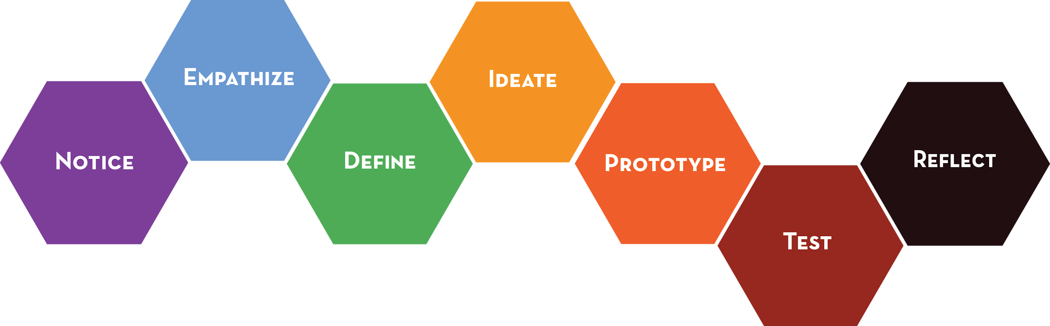
I LIKE
I WONDER
I WISH
I WILL
NOTE TO SELF:
Notes:
Here is a tool to help you reflect on the rigorous work of creativity and equity consciousness. Definitions will remind you of the modes you practiced today. The modes have been divided into quadrants: I LIKE, I WISH, I WONDER and I WILL.
Part 1. 10 minutes to acknowledge and own your work (glitz and warts) throughout the design thinking process
Part 2. 10 minutes (5 minutes ea.) to share with a partner (important that a certain level of intimacy or collegiality is formed before this moment)
Part 3. 10 minutes Whole group share (be sure to pause before choosing someone to share. This will allow for introverts to have a chance and non-dominant cultures in the room to have voice

Slide 36
NOTICE
Emotions, actions, insights + impact
SHARE
Our learning, our process + Opportunities to Co-Design
Notes:
The REFLECT phase of the process is ongoing and transparent throughout the design thinking process. It allows you and your team the time to notice, focus and reflect on your actions, emotions, insights and impact as designer(s) and human(s) on/with your users/context.

Slide 37

Notes:
This is what you practiced today:

Slide 38
Paseo
Protocol
What’s Your Why?
Oppression
Self-Awareness Tool
Constructivist Listening
Empathy
Interview
Constructivist Listening
Engage
Immerse
POV MadLib
Complicated vs Complex
HMW
Need Statement
Brainstorm
Yes, and…
Defer Judgement
Brainwrite
Constraints
Rapid
Prototyping
Build to Learn
Safe to Fail Experiments
Co-designer Testing
Role Play Testing
Storytelling
Think Aloud
Dyad Testing
Reflect Write
Reflect Time
Equity Pause
METHODS
Notes:
Methods-
Sometimes the method is the tool
Sometimes the tool allows you to practice the method

Slide 39
Paseo
Protocol
Notice Tool
Constructivist Listening
Empathy
Interview
AEIOU
Immersion
Composite User
POV MadLib
HMW
Need Statement
Empathy Map
Brainstorm
Brainwrite
Constraints
Levers
Looks Like/
Works Like
Rapid
Prototyping
Build to Learn
User Testing
Role Play Testing
Storytelling
Think Aloud
Dyad Testing
Equity Pause
Reflect Write
Dyad Convo
METHODS
Focus on Human Values
Practice Self-
Awareness
Notice Bias +
Power
Embrace Complexity
Build Relational Trust
Build Relational Trust
Focus on Human Values
Embrace Complexity
Liberatory
Collaboration
Bias Toward Experimen- tation
Build Emotional
Trust
Liberatory
Collaboration
Bias Toward Action
Build Relational Trust
Show Don’t Tell
Craft Clarity
Craft Clarity
Practice Self-
Awareness
Bias Toward Experimen- tation
Share Don’t Sell
Focus on Human Values
Practice Self-
Awareness
Embrace Complexity
Craft Clarity
Build Relational Trust
Craft Clarity
Embrace Complexity
Practice Self-
Awareness
Define Bias +
Power
MINDSETS
Notes:
Conversation
Methods-
Sometimes the method is the tool
Sometimes the tool allows you to practice the method
Mindsets-
Are developed through the ongoing practice

Slide 40

As a ______(identity)________DESIGNER at XXXX School, I strive to build______(what)______ because___________(why)_____________.
As a striving EQUITY-CENTERED DESIGNER, I recognize I need to notice ______(what)________ when I________ ((action))________by____(how)_____ so_______(equitable outcome of why)________.

Slide 41
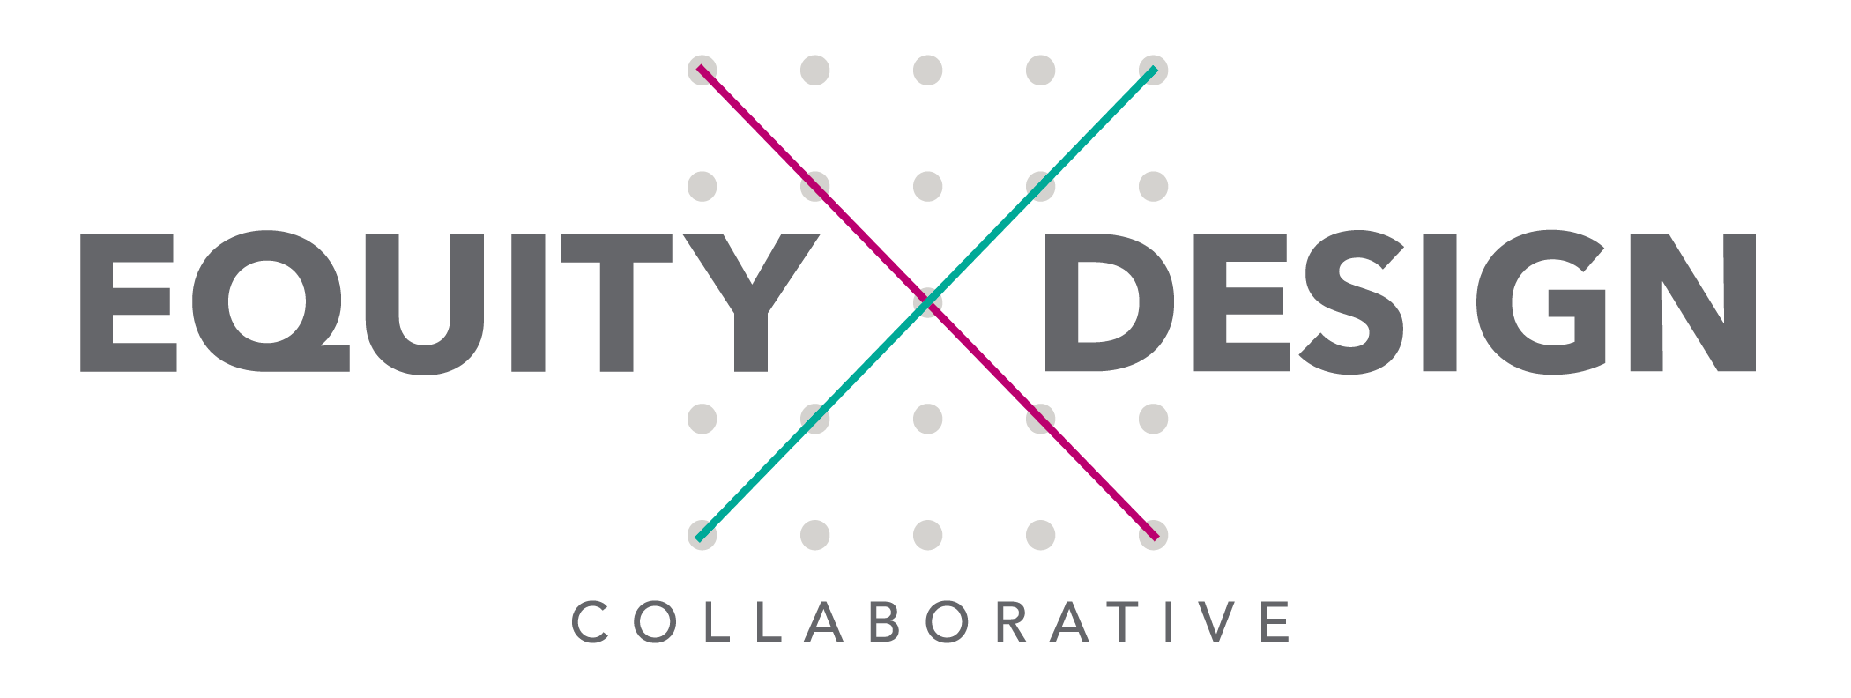


Our Collaborators in exploring equity/justice-centered design!
(our growing community)...
@equitydeigncollaborative
#liberatorydesign
Notes:
We are a part of a growing community of equity/justice-centered designers:
National Equity Project
equityXdesign (Christine Ortiz, Michelle Molitor, Caroline Hill)
https://medium.com/@multiplyequity/racism-and-inequity-are-products-of-design-they-can-be-redesigned-12188363cc6a#.8hia4f29y
Creative Reaction Lab (Antoinette Carroll)
https://www.fastcodesign.com/3068235/want-to-fight-inequality-forget-design-thinking
Reflex Design Collective (Brooke Staton, Pierce Gordon & others)
http://contested-cities.net/working-papers/wp-content/uploads/sites/8/2016/07/WPCC-165008-StatonKramerGordonValdez-FromTechnicalToPolitical.pdf
Design Justice
https://designjusticeplatform.com

